Slide 1
Digital Portfolio
STUDENT NAME:PAVITHRA.R
REGISTER NO AND NMID: 8CA992F2660E2909E4844F8BBA55B1D8
DEPARTMENT: BSC COMPUTER SCIENCE
COLLEGE: COLLEGE/ UNIVERSITY
TIRUPPUR KUMARAN COLLEGE FOR WOMEN
BHARATHIYAR UNIVERSITY

Slide 2
PROJECT TITLE
AI DEVELOPER

Slide 3


AGENDA
Problem Statement
Project Overview
End Users
Tools and Technologies
Portfolio design and Layout
Features and Functionality
Results and Screenshots
Conclusion
Github Link
3/21/2024 Annual Review

Slide 4

PROBLEM STATEMENT
A problem statement is a concise explanation of the problem, its context, and why it needs to be addressed.

Slide 5

PROJECT OVERVIEW
A project overview is a concise description of what the project is about, why it is being done, and what it aims to achieve

Slide 6

WHO ARE THE END USERS?
End users are the final users who directly interact with and benefit from a product or service

Slide 7

TOOLS AND TECHNIQUES
Tools are the instruments/software used, and techniques are the methods/approaches applied to solve a problem or perform work.

Slide 8
POTFOLIO DESIGN AND LAYOUT
Portfolio design and layout is the structured arrangement of content, visuals, and style to display skills, projects, or achievements in an appealing way.
8

Slide 9
FEATURES AND FUNCTIONALITY
Features are the characteristics of a product, while functionality is how those features perform to meet user needs.

Slide 10
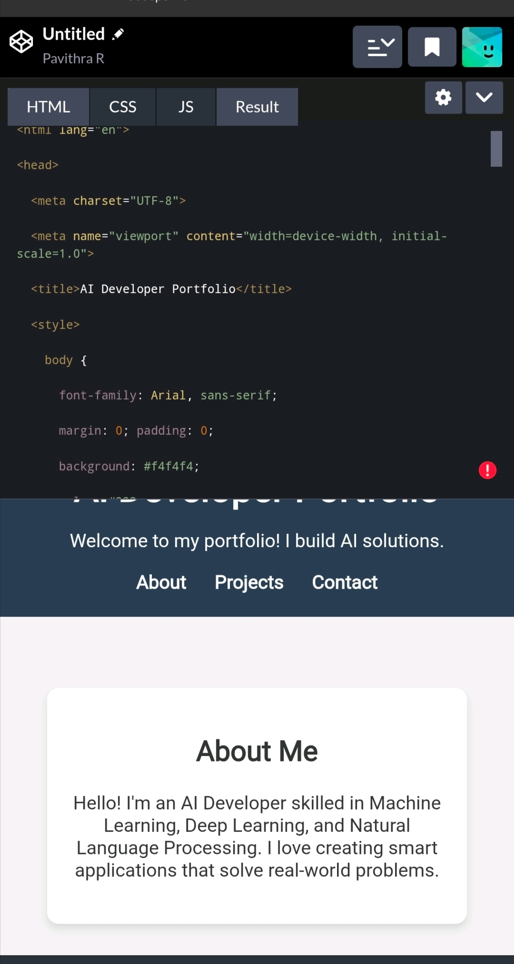

RESULTS AND SCREENSHOTS
3/21/2024 Annual Review
10

Slide 11
CONCLUSION
A conclusion is a brief summary that wraps up the discussion and presents the final outcome or message.
11

